Slide 1
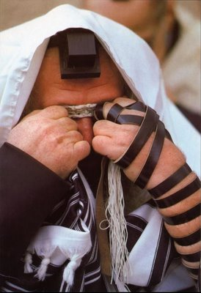
Don’t Forget!
Leviticus 23
Dr. Rick Griffith, Crossroads International Church Singapore
BibleStudyDownloads.org

Slide 2
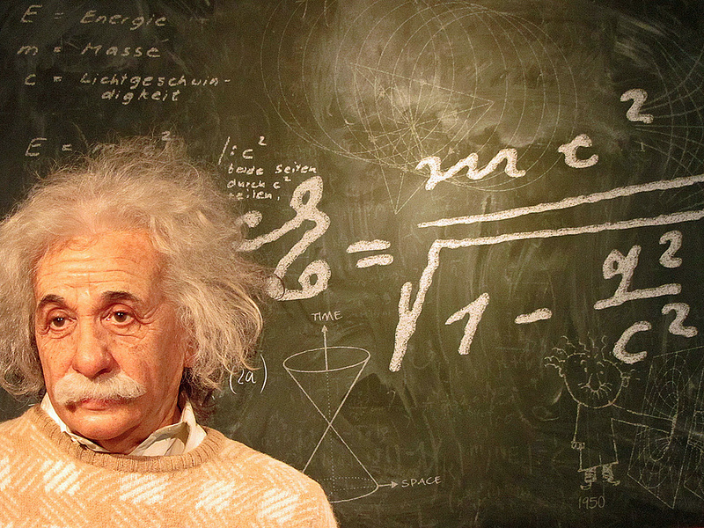
Albert Einstein

Slide 3
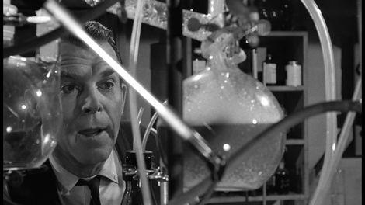
Absent-Minded Professors

Slide 4
How can we remember God’s provisions with thankful hearts?

Slide 5
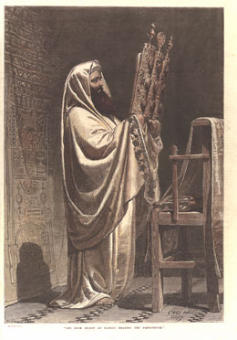
I. Israel regularly remembered God’s provisions by rest and gathering together (Lev. 23)
134
Holy Day Celebrations in the Old Testament

Slide 6
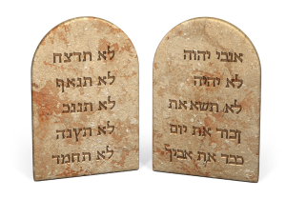
Don’t work

Slide 7
Sabbath

Slide 8
Weekly Sabbath
Feasts
Leviticus 23
Leviticus 23
1 Nisan
2 Iyar
3 Sivan
4 Tammuz
5 Av
6 Ellul
7 Tishri
8 Cheshvan
9 Kislev
10 Tevet
11 Shevat
12 Adar
Rest and remember covenant
Christ our Rest-giver in the kingdom
Notes:
#81 in original file

Slide 9
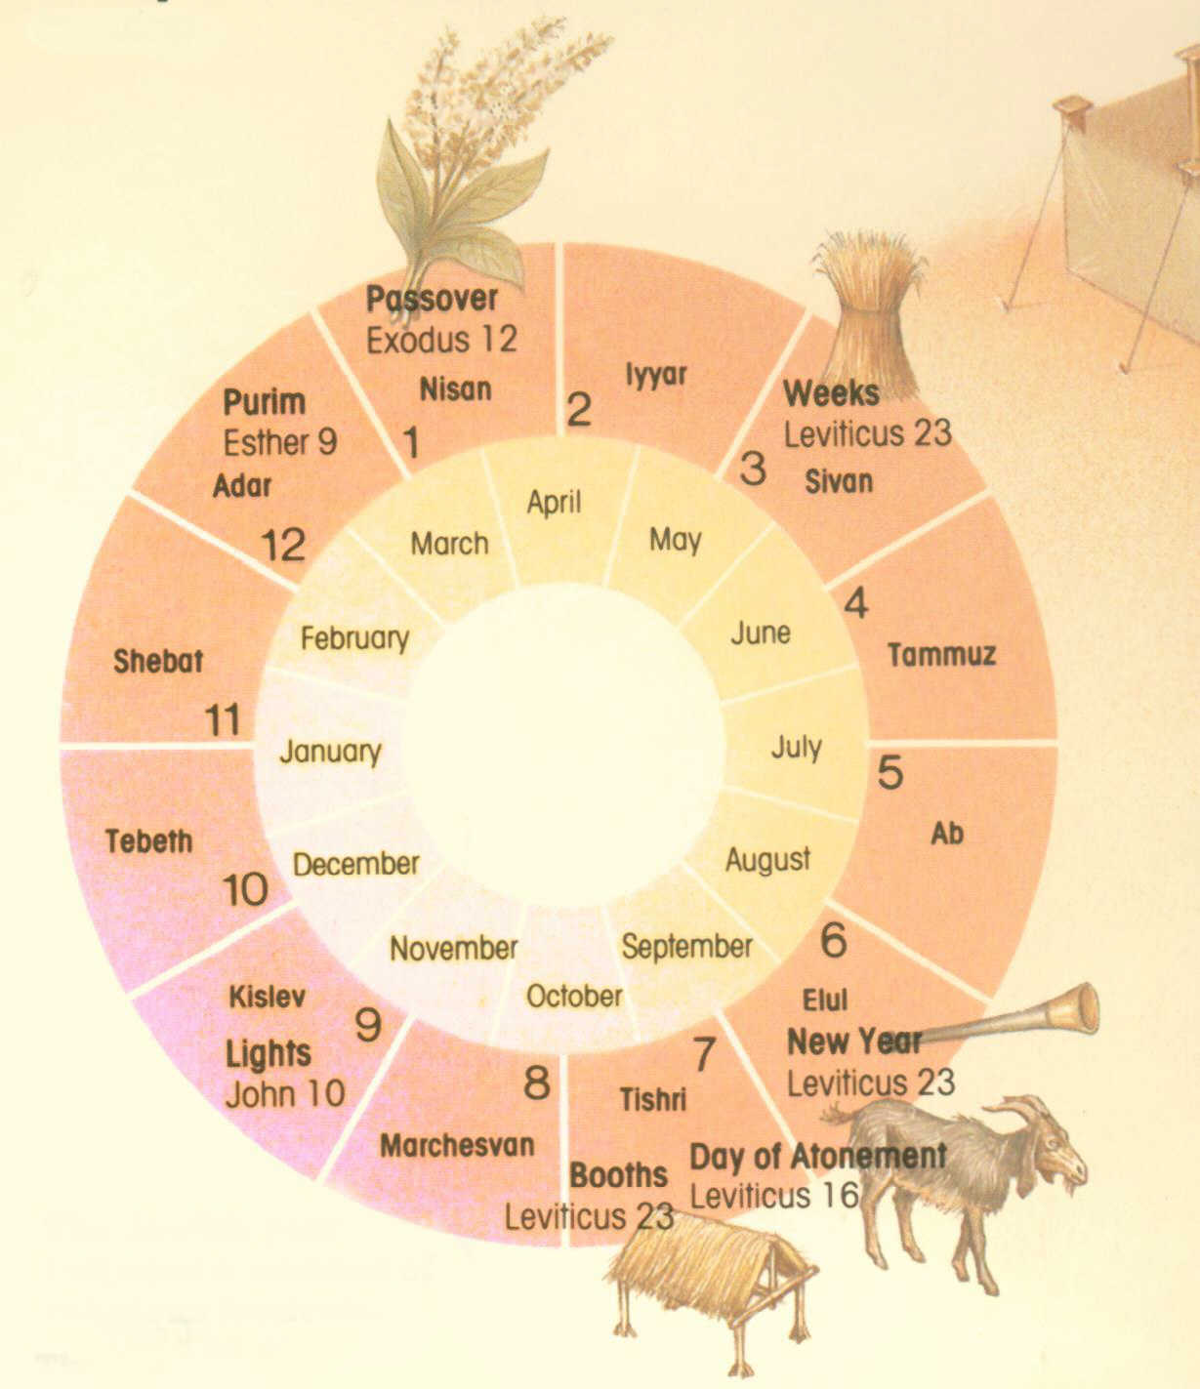
The Seven Feasts
Leviticus 23
Passover
Unleavened Bread
Firstfruits
Pentecost
Trumpets
Atonement
Tabernacles
1 Nisan
2 Iyar
3 Sivan
4 Tammuz
5 Av
6 Ellul
7 Tishri
8 Cheshvan
9 Kislev
10 Tevet
11 Shevat
12 Adar
Notes:
#80 in original file

Slide 10
Passover
Feasts
Leviticus 23
1 Nisan
2 Iyar
3 Sivan
4 Tammuz
5 Av
6 Ellul
7 Tishri
8 Cheshvan
9 Kislev
10 Tevet
11 Shevat
12 Adar
Recalls Exodus
Christ our redeemer
Notes:
#82 in original file

Slide 11
Unleavened Bread
Feasts
Leviticus 23
1 Nisan
2 Iyar
3 Sivan
4 Tammuz
5 Av
6 Ellul
7 Tishri
8 Cheshvan
9 Kislev
10 Tevet
11 Shevat
12 Adar
Dependence on Egypt broken
Christ our sanctifier
Notes:
#82 in original file

Slide 12
Firstfruits
Feasts
Leviticus 23
1 Nisan
2 Iyar
3 Sivan
4 Tammuz
5 Av
6 Ellul
7 Tishri
8 Cheshvan
9 Kislev
10 Tevet
11 Shevat
12 Adar
Dedicate harvest
Christ's resurrection
Notes:
#83 in original file

Slide 13
Pentecost
Feasts
Leviticus 23
1 Nisan
2 Iyar
3 Sivan
4 Tammuz
5 Av
6 Ellul
7 Tishri
8 Cheshvan
9 Kislev
10 Tevet
11 Shevat
12 Adar
Thanksgiving
Birth of Church
Notes:
#84 in original file

Slide 14
Trumpets
Feasts
Leviticus 23
1 Nisan
2 Iyar
3 Sivan
4 Tammuz
5 Av
6 Ellul
7 Tishri
8 Cheshvan
9 Kislev
10 Tevet
11 Shevat
12 Adar
New Year Repentance
Rapture
Notes:
#85 in original file

Slide 15
Atonement
Feasts
Leviticus 23
1 Nisan
2 Iyar
3 Sivan
4 Tammuz
5 Av
6 Ellul
7 Tishri
8 Cheshvan
9 Kislev
10 Tevet
11 Shevat
12 Adar
Atone for sins
Christ our atonement
Notes:
#86 in original file

Slide 16
Tabernacles
Feasts
Leviticus 23
1 Nisan
2 Iyar
3 Sivan
4 Tammuz
5 Av
6 Ellul
7 Tishri
8 Cheshvan
9 Kislev
10 Tevet
11 Shevat
12 Adar
Celebrate harvest & remember wilderness blessings
Millennial rest
Notes:
#87 in original file

Slide 17
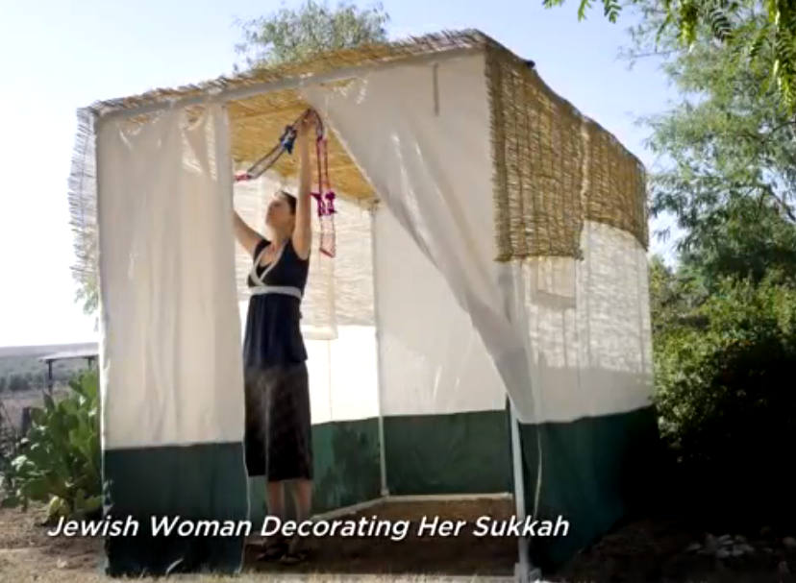
Jewish Woman Decorating Her Sukkah

Slide 18
II. We should remember God’s provisions through times of corporate rest and celebration.

Slide 19
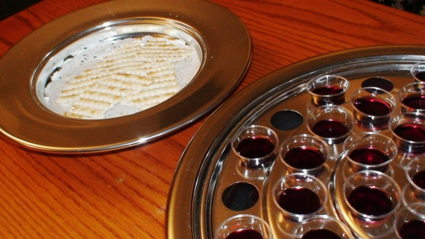
Main Idea
This Lord’s Supper chapel is our corporate time set aside so we won’t forget God’s greatest provision

Slide 20
Black

Slide 21
OT Sermons link at BibleStudyDownloads.org
Get this presentation and script for free!

